Slide 1
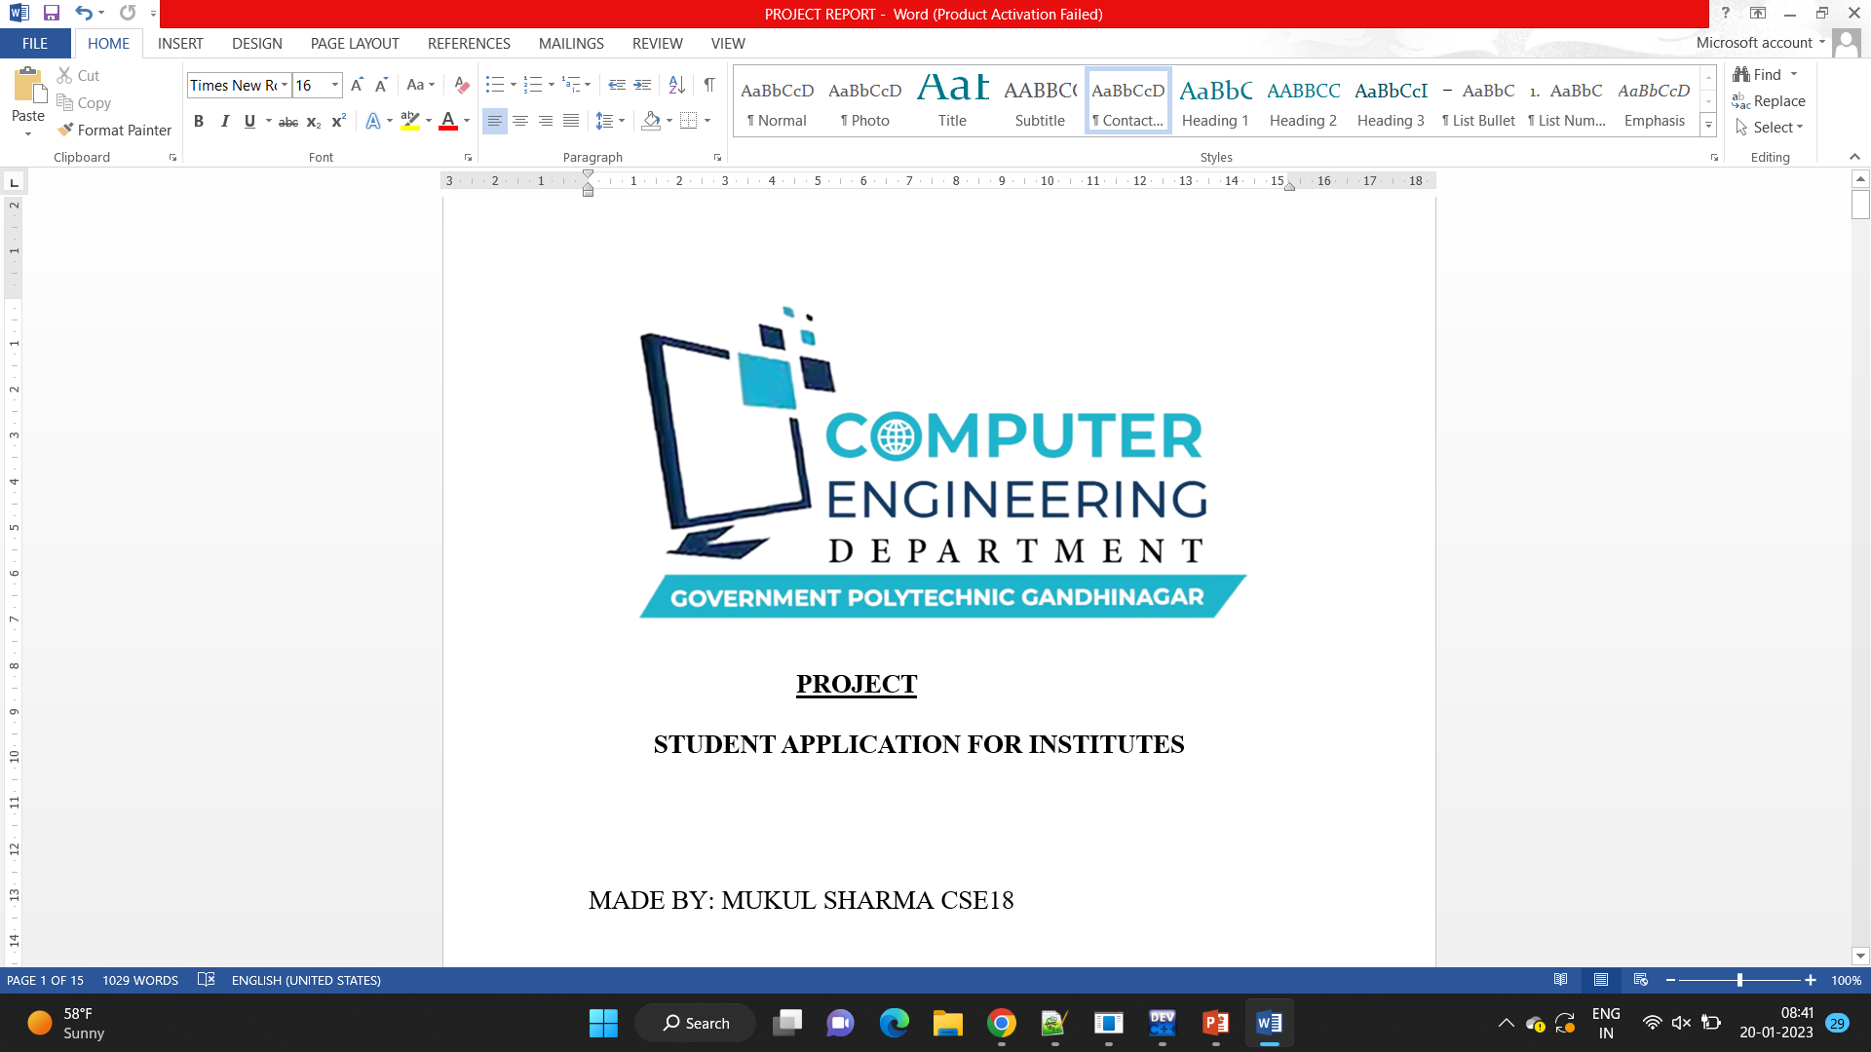

Slide 2
Government polytechnic gandhinagar
The Government Polytechnic Gandhinagar is situated in very proximity of industrial estate that too in the state capital city and the industrial estate declared as Electronics Gujarat Industrial Development Corporation (GIDC) Estate, which is the customer and supplier too. As a customer we say this institute serve them by supplying the semi finished stock of pass out employing them in mining full way building there real interest viz profit, quality, landmark, optimized productivity and excellencies achievement Established under World Bank Assistance in year 1991.
Institute is spread in total 12 acre of area split in to strategic best academic formation with multiple academic houses in.

Slide 3
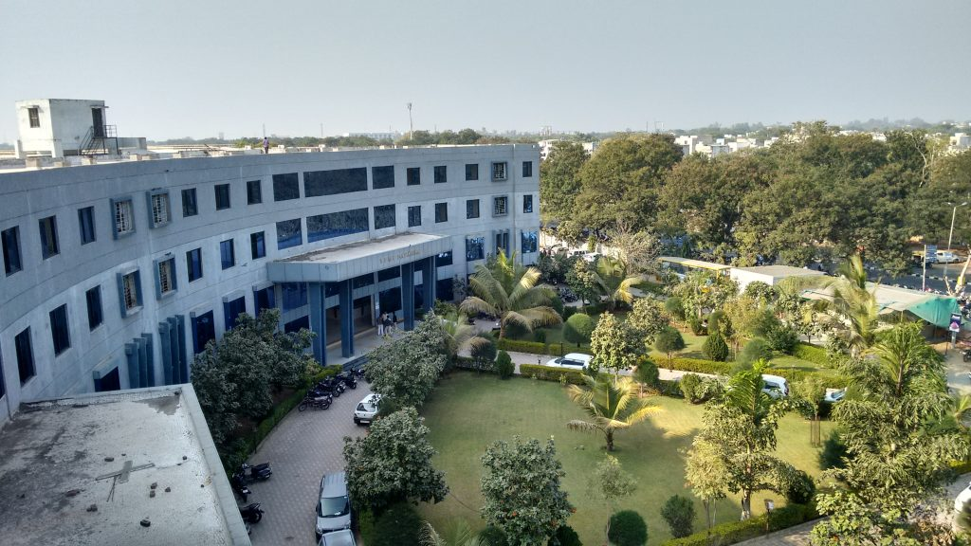
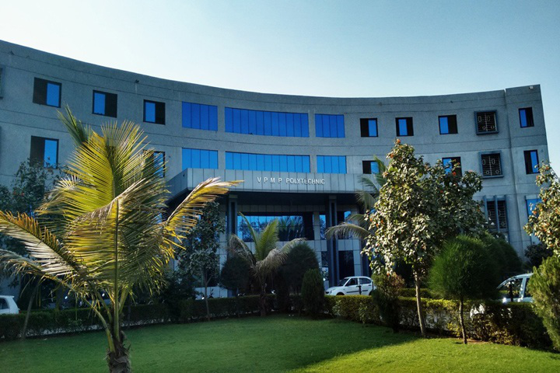

Slide 4
Institute Vision
To Develop technically proficient and ethically sound diploma engineers contributing to industry and society needs.
Institute Mission
To impart quality technical education.
To shape students towards sensitizing in ethical values and contributing in nature.
To familiarize students with the world of work

Slide 5
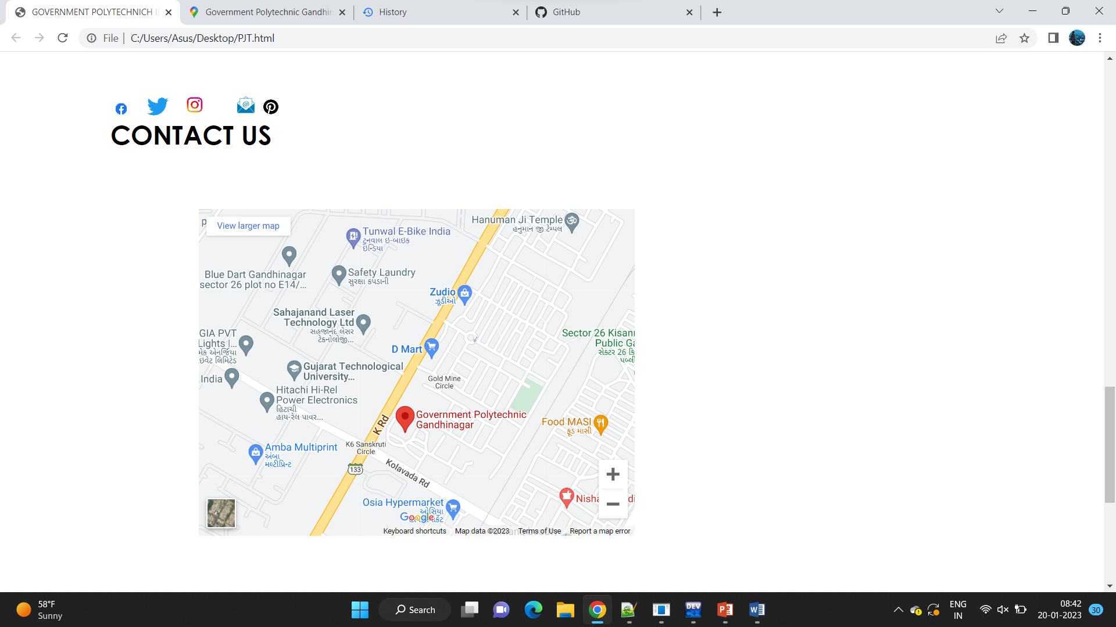

Slide 6
Government Polytechnic Institute
sector 15 GANDHINAGAR
8866185893
Monday to Saturday,10Am to Pm
ms9409621877@gmail.com
For any query

